Slide 1
Big Mountain Resort

Slide 2
Problem Identification
Big Mountain Resort, with about 350,000 visitors every year, recently installed a chair lift to help increase the distribution of visitors across the mountain.
This increases the operating costs by $1.54M this season.
And resort’s current pricing strategy to charge a premium above the average price of resorts in its market segment seems to have certain limitations as it isn’t taking into account the facilities offered by the resort.
Therefore, to counter the increase in costs, Big Mountain Resort is looking to revisit its current pricing strategy and implementing other changes that will either cut costs without undermining the ticket price or will support an even higher ticket price.

Slide 3
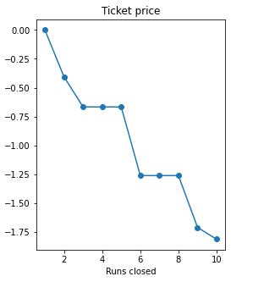
Recommendations & Key Findings
Using given dataset with details about resorts within Market Segment, we have built a model that predicts ideal Ticket Price and there by the Revenue, assuming 350000 visitors on an average and each skiing 5 days at the Big Mountain Resort, based on the facilities offered by the Resort.
It has been identified that Big Mountain Resort is currently undercharging and there is room for increasing the Ticket Price to up to $95.87 with the current facilities.
Plotting change in Price & Revenue by Number of Runs Closed, closing one run makes no difference, while closing 2 and 3 successively reduces support for ticket price. Closing 3 or 4 or 5 runs has equal impact on the price while closing any more than 6 runs significantly drops the price.
Increasing vertical drop by 150 feet and installing an additional chair lift can support increase in ticket price by $1.99 and revenue by $3474638.
Slight increase in snow making area by 4 acres or Longest Run by 0.2mile has no impact on the price.

Slide 4
Modeling and Analysis
We first built a Linear Regression Model using 5-fold cross-validation and feature selection, resulting in Mean Absolute Error of 10.49 on Training Dataset and 11.79 on Test Dataset.
8 features listed below in the order of importance have been identified to be useful in predicting the price.
vertical_drop 10.767857
Snow Making_ac 6.290074
total_chairs 5.794156
fastQuads 5.745626
Runs 5.370555
LongestRun_mi 0.181814
trams -4.142024
SkiableTerrain_ac -5.249780

Slide 5
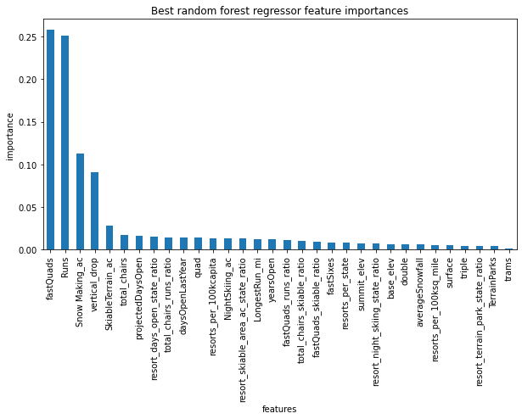
Modeling and Analysis
We then built Random Forest Model using 5-fold cross-validation resulting in Mean Absolute Error of 9.64 on Training Dataset and 9.53 on Test Dataset.
Top 4 features identified in the process are:
fastQuads
Runs
Snow Making_ac
vertical_drop

Slide 6
Summary
On comparing performance of both models, Random Forest Model resulted in low Cross Validation Mean Absolute Error consistently on both training and testing datasets, therefore has been used to
predict ticket price of $95.87 for Big Mountain Resort.
Provide recommendations on other initiatives that have been short-listed by business.

